Slide 1
Cyclistic User Trends: Casual vs. Annual Member
Rebecca Gordon
6/29/2024

Slide 2
Table of Contents
Title: Cyclistic User Trends: Casual vs. Annual Member
Table of Contents
Purpose Statement
Analysis and Visualization
Conclusion
Recommendations
Appendix

Slide 3
Purpose Statement
In order to develop marketing that converts casual riders into annual members, we need to understand any divergent trends in usage between user types.
This case study analyzes the last 6 months of historical data from Cyclistic Bike-Share to uncover these trends.
Analysis examines average trip durations, total trip counts, days of the week, and demographic data on gender and age group for answers.

Slide 4
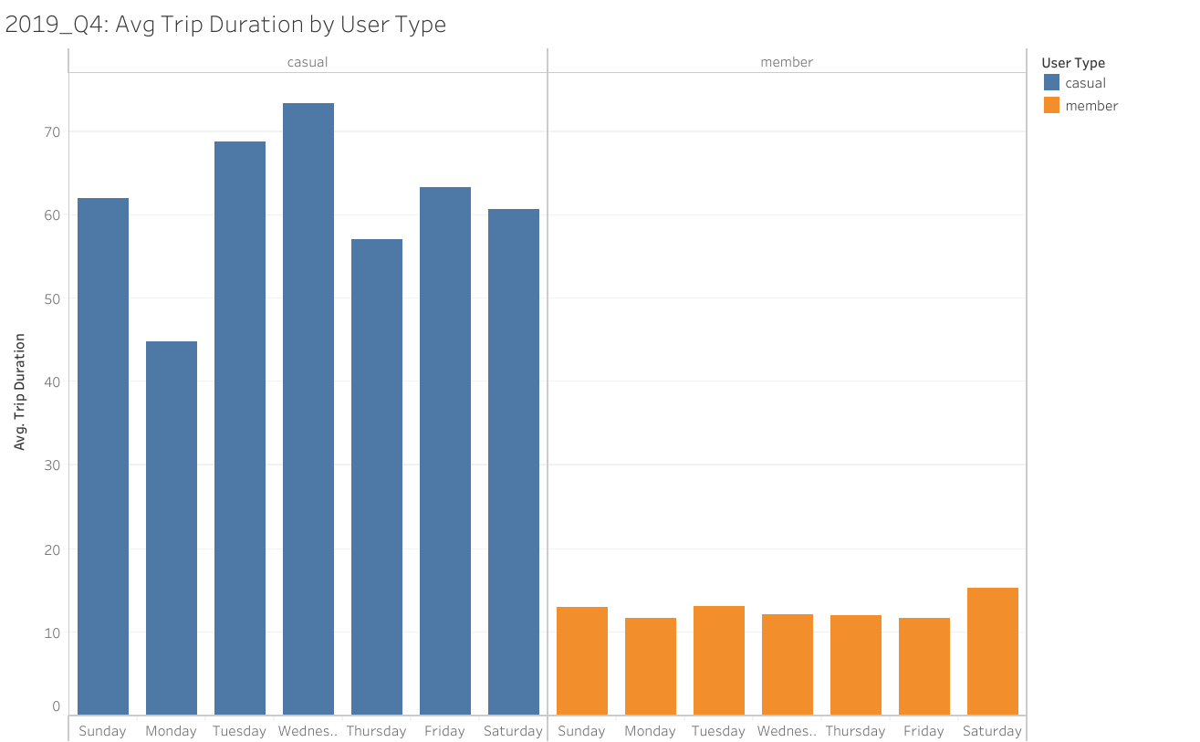
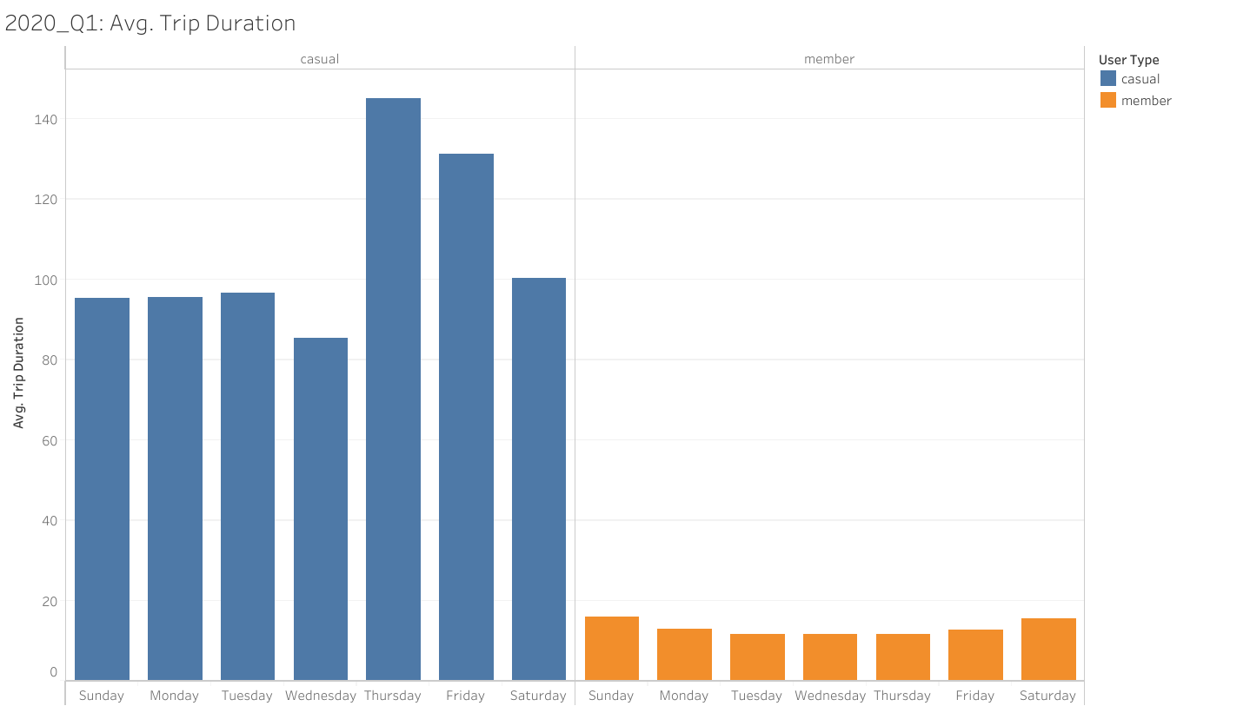
AVG Trip Duration
Higher in Casual Users
Casual Users have a higher average trip duration across all days of the week.
Annual members have consistently lower average trip duration across days of the week.
This may be due to annual members utilizing service for daily commutes and chores, while casual users utilize the service for longer occasional rides that don’t reflect daily activities.

Slide 5
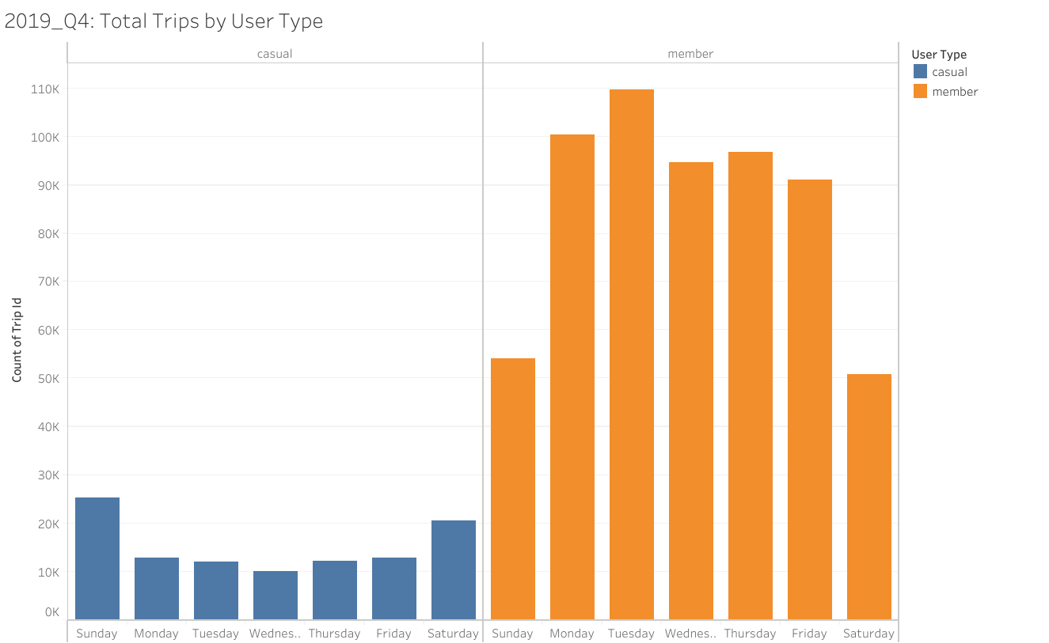
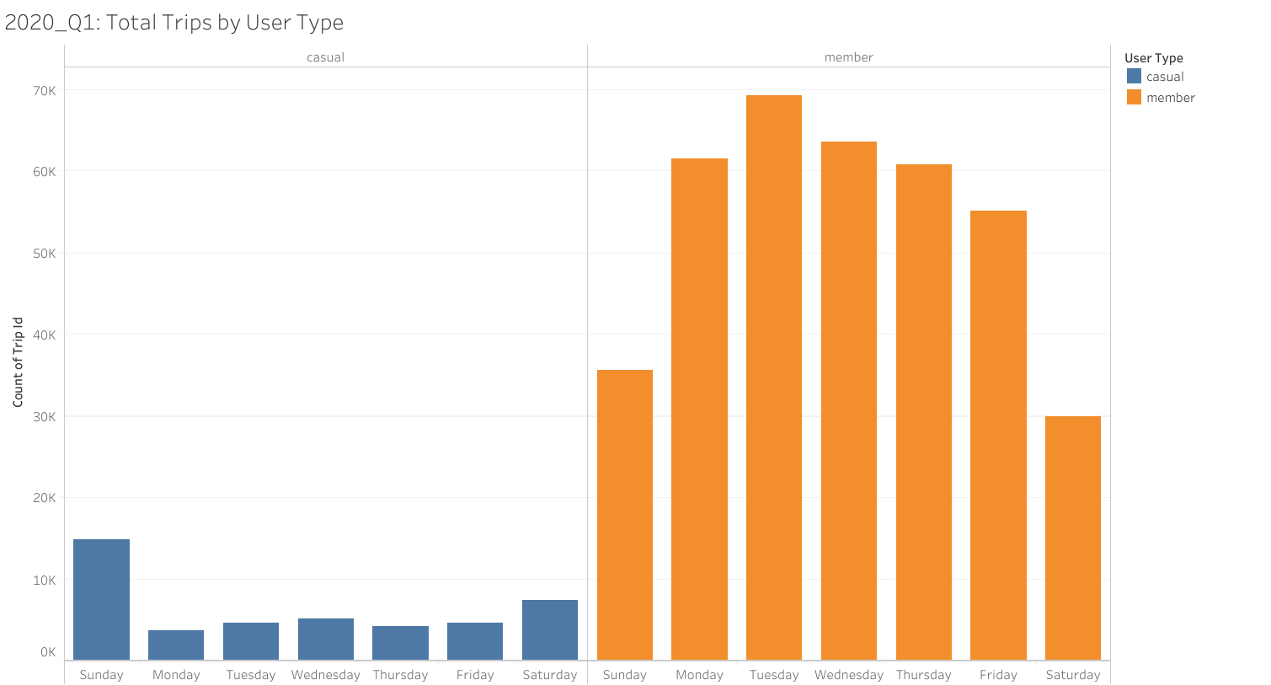
Total Trips
Higher in Annual Members
Annual Members have higher total trips across all days of the week.
Annual Members have lower trip counts on the weekends.
Casual users have consistently lower total trips across all days of the week.
Casual users have higher trip counts on weekends, particularly on Sundays.
This strengthens the earlier assumptions of annual members taking shorter but more frequent rides tied into daily activities, while casual users take longer rides, but less frequently.

Slide 6
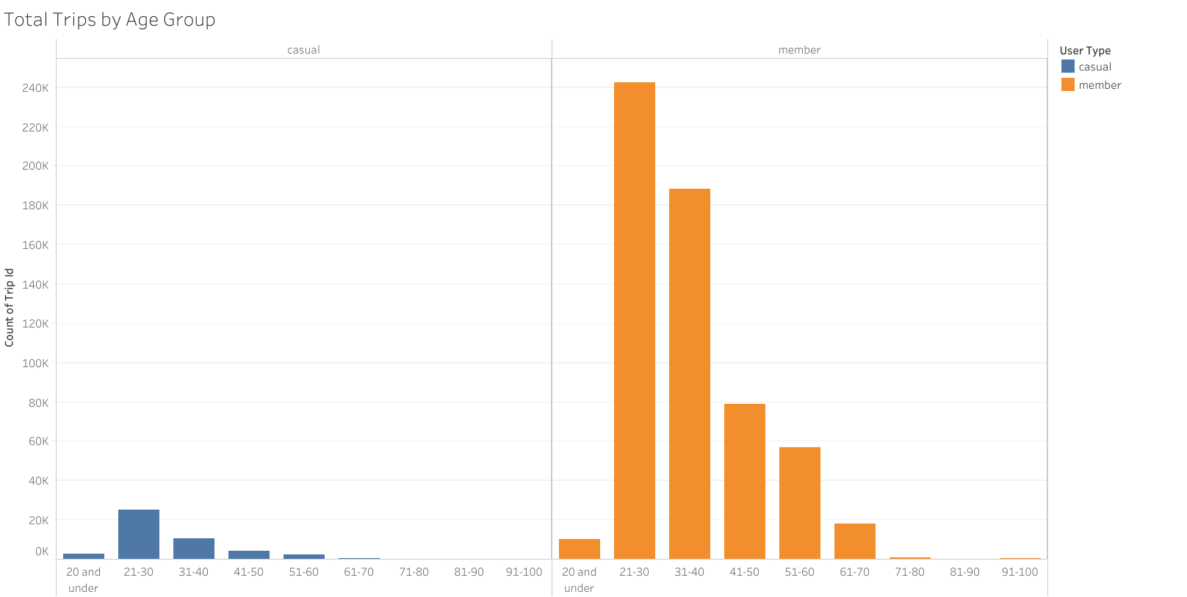
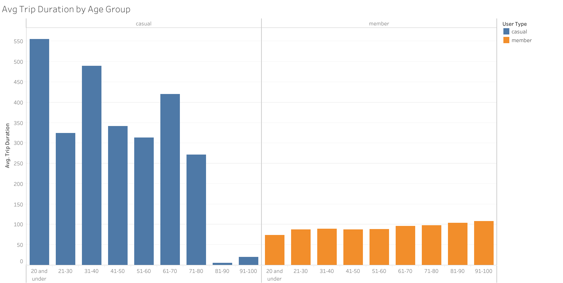
Age Groups
When looking at total trip values by age group it was apparent that 21-30 and 31-40 were the biggest age groups for both types of users.
Levels of total trips reflected the higher numbers of trips taken by members vs casual users.
There was not an obvious trend in average trip duration per age group across user type.

Slide 7
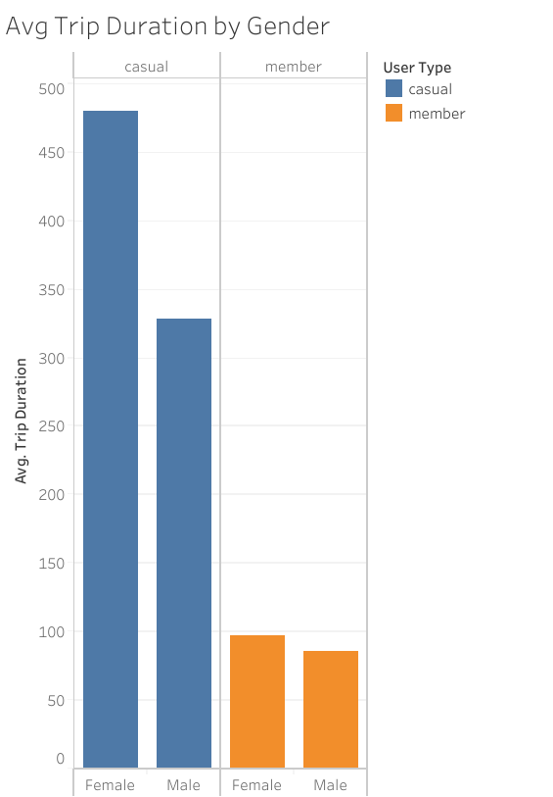
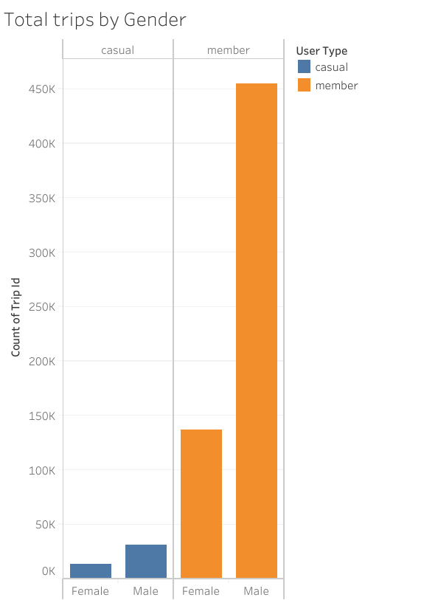
Gender
No obvious trends in average trip duration across gender.
In total trips there does seem to be a trend of higher total trip values in males vs females across both user groups.

Slide 8
Conclusion
Analysis indicates:
Casual users have higher average trip durations, but lower total trips than annual members.
The largest age groups for both user types are 21-30 and 31-40.
Leveraging these facts will lead to the best marketing plans for rider conversion.
Consequently, we can conclude that members make more consistent use of the service but go shorter differences whereas casual users take less rides but take much longer duration rides. No other analysis across gender, age group, or day of the week, produced as obvious a trend as this inverse pattern of average trip duration and total trips.

Slide 9
Recommendations
My first recommendation is create an adaptation to the pricing model that takes casual rider’s less frequent, but longer rides into account. This could be to promote a more convenient bundle for multi-stop rides, or add a mid-tier membership that covers a set number of rides per month.
My next two recommendations would be to increase marketing to the two largest rider groups. We could target young professionals (21-30) by partnering with local businesses frequented by this demographic like gyms and cafes to create bundle offerings.
We could also promote family ridership (31-40) by promoting deals for family outings and weekend adventures like discounts on multiple bike rentals together.

Slide 10
Appendix
There are links in the Case Study Document to:
Raw Data
Clean Data with Exploratory Analysis
Changelog
Tableau Profile Link for full Visualizations
Thank you!

